Slide 1
R
Decision making

Slide 2
if statement
if...else statemen
switch statement

Slide 3
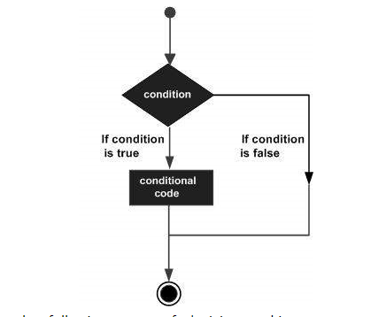
Flow diagram for Decision

Slide 4
An if statement consists of a Boolean expression followed by one or more statements.
if(boolean_expression)
{
// statement(s) will execute if the boolean expression is true.
}

Slide 5
## Note about 30 - L
x <- 30L
if(is.integer(x)) {
print("X is an Integer")
}
30L - > Integer
30 -> Numeric

Slide 6
If-else
if(boolean_expression) {
// statement(s) will execute if the boolean expression is true.
} else {
// statement(s) will execute if the boolean expression is false.
}
## second
if...else if...else

Slide 7
x <- 1:100
typeof(x) # integer
y <- x+1
typeof(y) # double, twice the memory size
object.size(y) # 840 bytes (on win64)
z <- x+1L
typeof(z) # still integer
object.size(z) # 440 bytes (on win64)
Ref: https://stackoverflow.com/questions/7014387/whats-the-difference-between-1l-and-1

Slide 8
switch
switch(expression, case1, case2, case3....)
A switch statement allows a variable to be tested for equality against a list of values. Each value is called a case, and the variable being switched on is checked for each case.

Slide 9
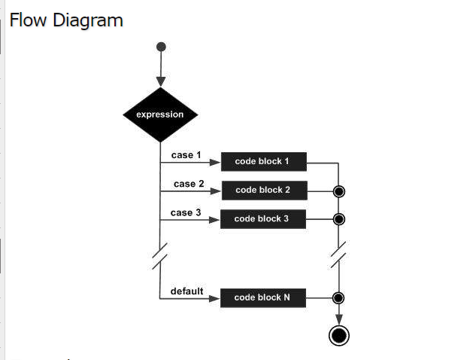

Slide 10
The switch() function in R tests an expression against elements of a list. If the value evaluated from the expression matches item from the list, the corresponding value is returned.

Slide 11
> switch(2,"red","green","blue")
[1] "green"
> switch(1,"red","green","blue")
[1] "red“
switch("color", "color" = "red", "shape" = "square", "length" = 5)
The expression used in the switch () function can be a string as well. In this case, the matching named item’s value is returned.

Slide 12
Say, What if we have 12 alternatives to choose?, if we use Nested If Else in this situation, programming logic will be difficult to understand.

Slide 13
switch (Expression,
"Option 1" = Execute these statements when the expression result match Option 1,
"Option 2" = Execute these statements when the expression result match Option 2,
"Option 3" = When the expression result match Option 3,Execute these statements,
....
....
"Option N" = When the expression result match Option N,Execute these statements,
Default Statements
)

Slide 14
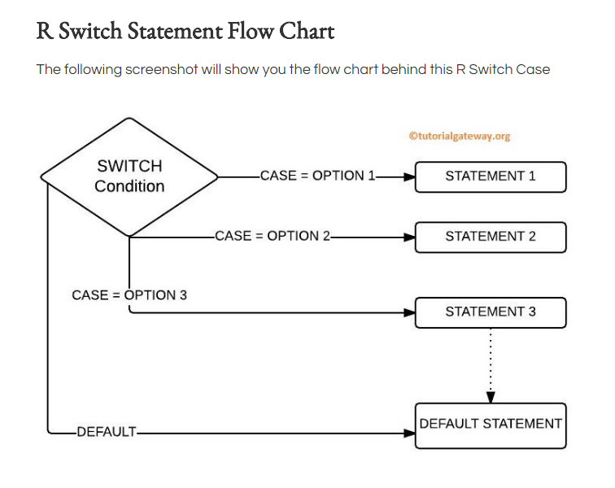

Slide 15
# R Switch Case Example
switch(3,
"Learn",
"R Programming",
"Tutorial",
"Gateway"
)

Slide 16
# R Switch Statement Example
number1 <- 30
number2 <- 20
#operator <- readline(prompt="Please enter any ARITHMETIC OPERATOR You wish!: ")
operator = "+"
switch(operator,
"+" = print(paste("Addition of two numbers is: ", number1 + number2)),
"-" = print(paste("Subtraction of two numbers is: ", number1 - number2)),
"*" = print(paste("Multiplication of two numbers is: ", number1 * number2)),
"^" = print(paste("Exponent of two numbers is: ", number1 ^ number2)),
"/" = print(paste("Division of two numbers is: ", number1 / number2)),
"%/%" = print(paste("Integer Division of two numbers is: ", number1 %/% number2)),
"%%" = print(paste("Division of two numbers is: ", number1 %% number2))
)
print("default statenent")

